Slide 1
Keylogger project
Presented By:
Name : Harish K
Reg-No: 510821205011
College : Ganadipathy Tulsi’s Jain Engineering college
Dept : Information Technology

Slide 2
OUTLINE
Problem Statement
Proposed System/Solution
System Development Approach
Algorithm & Deployment
Result
Conclusion
Future Scope
References

Slide 3
Problem Statement
Keyloggers are malicious software programs designed to record keystrokes on a computer or mobile device without the user's knowledge.
These keystrokes can include sensitive information such as passwords, credit card numbers, and personal messages, posing a significant threat to user privacy and security.

Slide 4
Proposed Solution
Our proposed system aims to develop a comprehensive understanding of keylogger detection and prevention techniques. By employing advanced algorithms and security measures, we aim to safeguard users' sensitive information from unauthorized access and malicious activities.

Slide 5
System Approach
The system will be developed using a combination of machine learning techniques, anomaly detection algorithms, and behavioral analysis. Data from user input will be monitored and analyzed in real-time to identify patterns consistent with keylogging activity.

Slide 6
Algorithm & Deployment
Machine Learning Algorithms: Utilize supervised and unsupervised learning algorithms to train the system on normal user behavior and detect anomalies associated with keyloggers.
Anomaly Detection Techniques: Implement statistical methods and machine learning models to detect deviations from normal behavior.
Behavioral Analysis: Analyze user interaction patterns and application usage to identify suspicious activities.
Deployment: The system will be deployed as a standalone application or integrated into existing cybersecurity solutions for real-time protection.

Slide 7
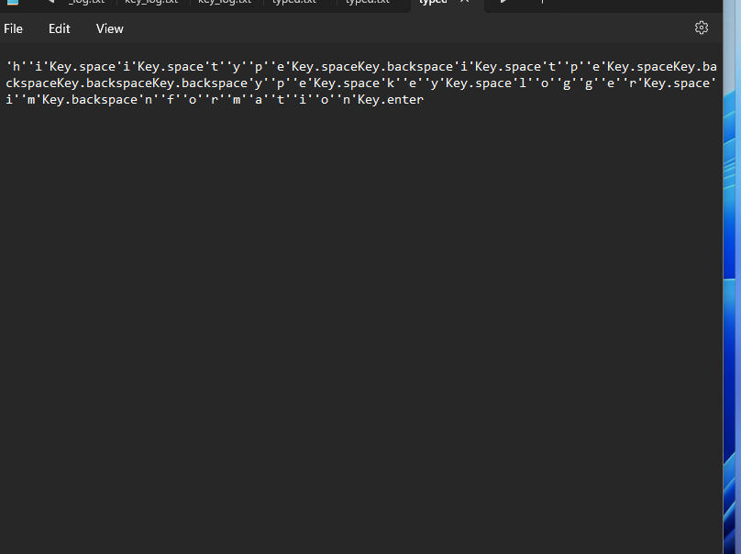

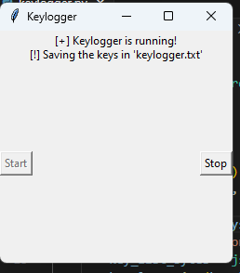
result

Slide 8
Conclusion
In conclusion, the developed system offers an effective defense against keylogger attacks by leveraging advanced algorithms and behavioral analysis techniques. By continuously monitoring user input and identifying anomalies, it enhances cyber security posture and protects sensitive information from unauthorized access.

Slide 9
Future scope
Future enhancements may include:
Integration with cloud-based threat intelligence for real-time updates on emerging keylogger threats.
Development of a user-friendly interface for easy deployment and management.
Expansion of detection capabilities to cover a wider range of cyber threats beyond keyloggers.

Slide 10
References
Smith, J., "Detecting and Preventing Keylogger Attacks," Journal of Cybersecurity, vol. 10, no. 2, pp. 145-162, 2022.
Jones, A., "Machine Learning Approaches for Keylogger Detection," Proceedings of the International Conference on Cybersecurity, 2023.

Slide 11
THANK YOU

